Slide 1




Big Data Analytics Pipeline
SAVEETHA SCHOOL OF ENGINEERING
SAVEETHA INSTITUTE OF MEDICAL AND TECHNICAL SCIENCES
CLOUD COMPUTING AND BIG DATA ANALYTICS-CSA1580
BIG DATA ANALYTICS PIPELINE
DONE BY: BALNE MANOJ
-192210193
GIVEN BY:DR.GNANA SOUNDARI
-BALNE MANOJ
192210193

Slide 2
What is a Big Data Pipeline?
Definition: A big data pipeline is a method for ingesting, processing, and analyzing large volumes of data from various sources. It involves a series of processing steps to prepare enterprise data for analysis.
Key Components: The pipeline includes data ingestion, transformation, and storage in a data lake or data warehouse for further analysis.
Importance: Understanding big data pipelines is crucial for efficiently handling and deriving insights from massive datasets.

Slide 3
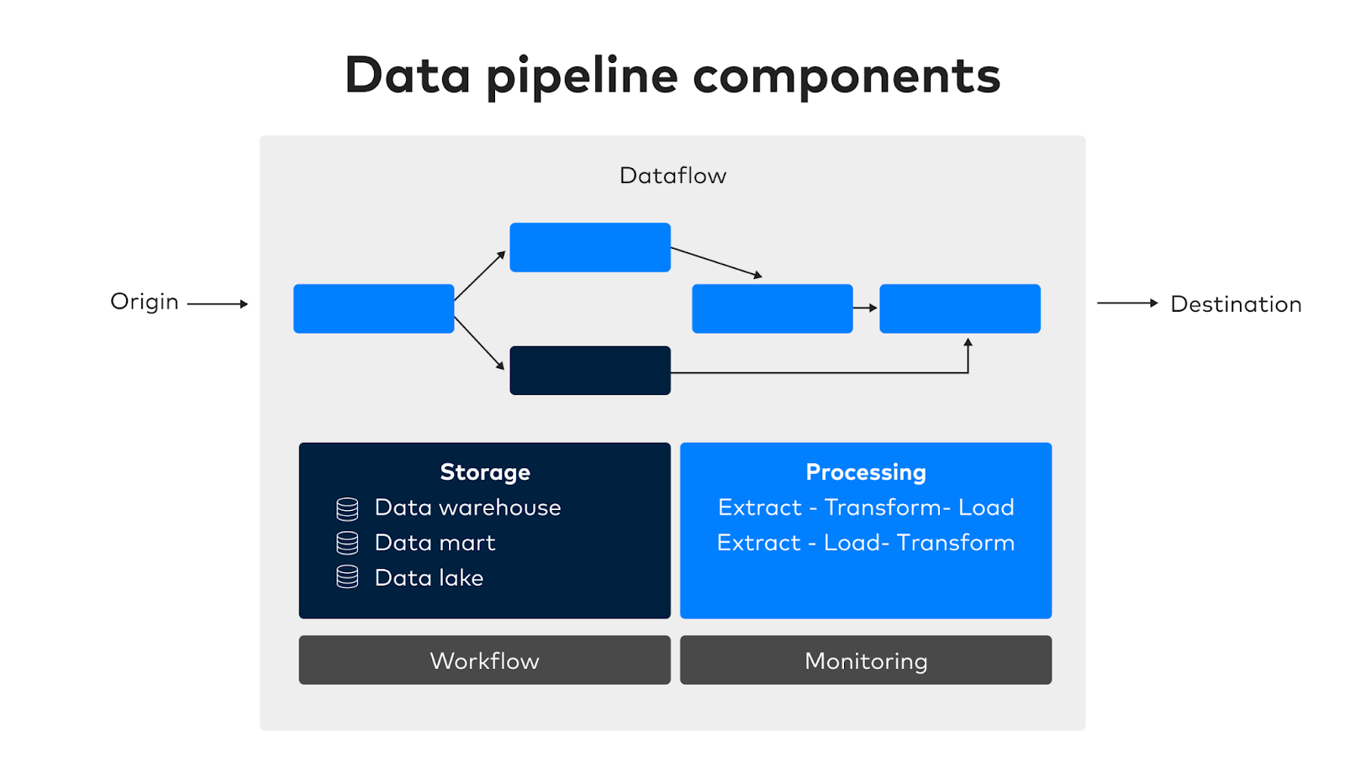

Slide 4
Components of a Data Science Pipeline :
Data Gathering: The process of collecting data from various sources, including databases, APIs, and cloud storage, to create a comprehensive dataset for analysis.
Data Processing: Involves cleaning, validating, and transforming the gathered data to ensure its accuracy and reliability for downstream analysis.
Insights Generation: Utilizing machine learning and analytics techniques to derive actionable insights from the processed data.
Key Point: The data science pipeline encompasses data gathering, processing, and insights generation to aid decision-making.

Slide 5
Performance and Efficiency
High Performance: Building data pipelines that can process large volumes of data with minimal latency, ensuring timely insights for decision-making.
Efficiency: Optimizing data pipelines to minimize resource utilization and operational costs while maintaining high performance.
Key Point: Balancing performance and efficiency is a critical challenge in big data analytics pipeline projects.

Slide 6
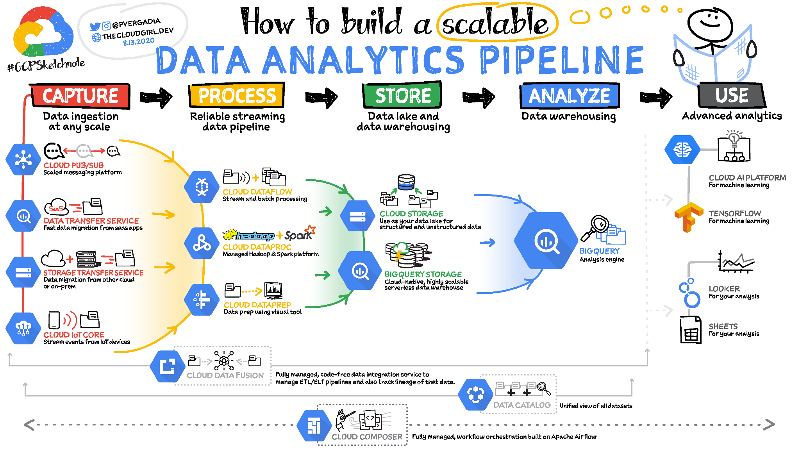

Slide 7
Data Validation and Cleansing :
Data Validation: Implementing techniques to ensure the accuracy and reliability of incoming data, preventing errors and inconsistencies in the pipeline.
Data Cleansing: Removing or correcting inaccurate or incomplete data to maintain the integrity of the data pipeline.
Key Point: Effective data validation and cleansing are essential for maintaining data quality in the pipeline.

Slide 8
Challenges and Benefits :
Challenges: Building and maintaining big data pipelines pose challenges related to scalability, performance, and end-to-end data flow management.
Benefits: Efficient big data pipelines enable organizations to derive valuable insights, make data-driven decisions, and gain a competitive edge in the market.
Use Cases: Real-world examples of big data pipelines and their impact on various industries and domains.

Slide 9
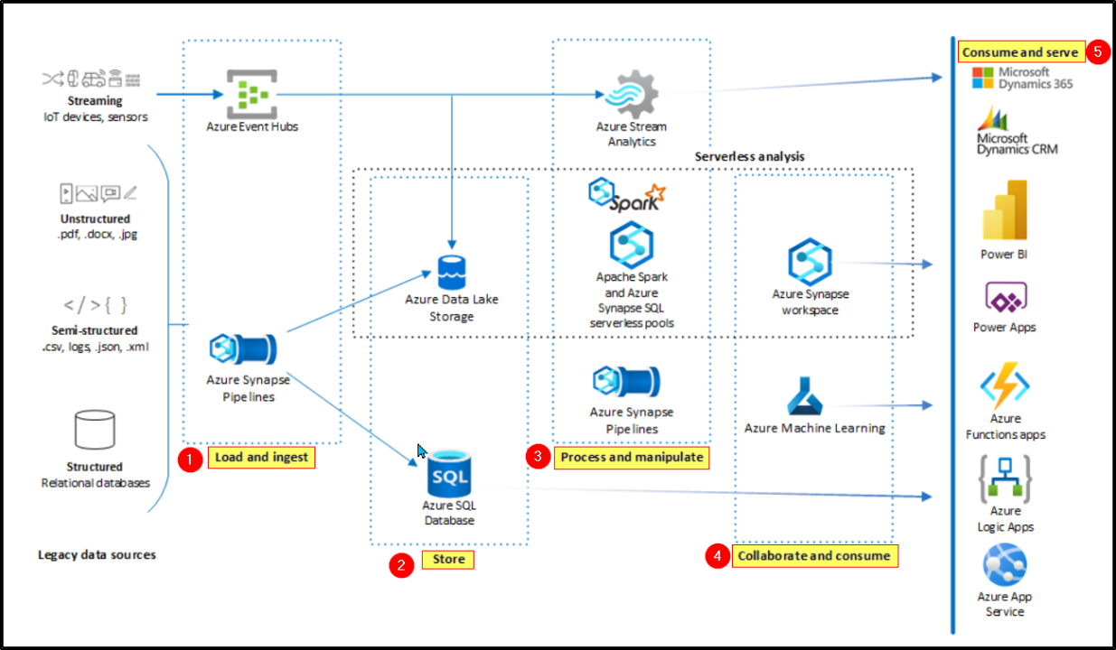

Slide 10
Cloud-Based Infrastructure :
Cloud Services: Utilizing cloud platforms for scalable storage, computing power, and data processing capabilities.
Data Security: Addressing data security and compliance considerations when building a cloud-based analytics pipeline.
Scalability and Flexibility: Leveraging the scalability and flexibility of cloud infrastructure for handling big data workloads.
Tools and Technologies :
Data Processing Tools: Overview of popular tools and technologies for data processing, such as Apache Spark, Hadoop, and Apache Flink.
Data Storage Solutions: Exploring cloud-based data storage options, including data lakes and data warehouses.
Analytics and Visualization: Integration of analytics and visualization tools for deriving insights from processed data.

Slide 11
Implementation and Best Practices:
Architecture Design: Design considerations for building an efficient and scalable cloud-based big data analytics pipeline.
Data Governance: Implementing data governance practices to ensure data quality, privacy, and compliance.
Performance Optimization: Best practices for optimizing the performance and efficiency of the analytics pipeline.
CONCLUSION:
This project offers valuable hands-on experience building and evaluating cloud-based big data pipelines. Students focus on scalability, performance, and cost-effectiveness, gaining critical skills for real-world big data.Evaluation covers key areas: data ingestion/processing efficiency, real-time processing capabilities, scalability for large data volumes, data storage effectiveness, cloud integration, and comprehensive documentation.

Slide 12
Thank you
-BALNE MANOJ
DONE BY: BALNE MANOJ
-192210193

